Slide 1
Quantitative Risk Analysis Results Using FAIR Smart Online Examination System (SOES) Scenario: Exam Question Leakage Course: Risk Analysis & Systems Testing Student Name: Ahmad Marwan AlMaghaireh Student ID: 23110205 Date: January 2026

Slide 2
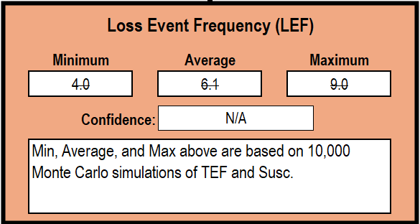
Loss Event Frequency (LEF)
LEF = Threat Event Frequency × Vulnerability
-Exam question leakage is not rare
-Successful loss events are expected multiple times per year
-Driven by:
Frequent access to exam data
High attacker motivation
Weak resistance controls (no MFA, limited monitoring)

Slide 3
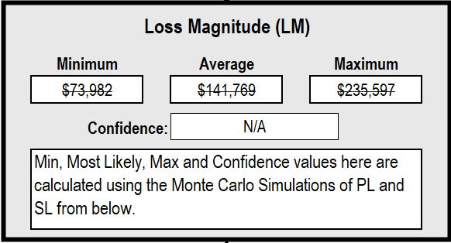
Loss Magnitude (LM)
Loss Magnitude = Primary Loss + Secondary Loss
What This Includes
Primary losses: exam rewriting, IT response, downtime
Secondary losses: student complaints, investigations, reputational impact

Slide 4
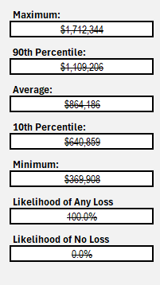
Annualized Loss Exposure (ALE)
Interpretation
The university is almost certain to incur losses every year
Average expected loss ≈ $865,000 annually
Worst-case year exceeds $1.6 million

Slide 5
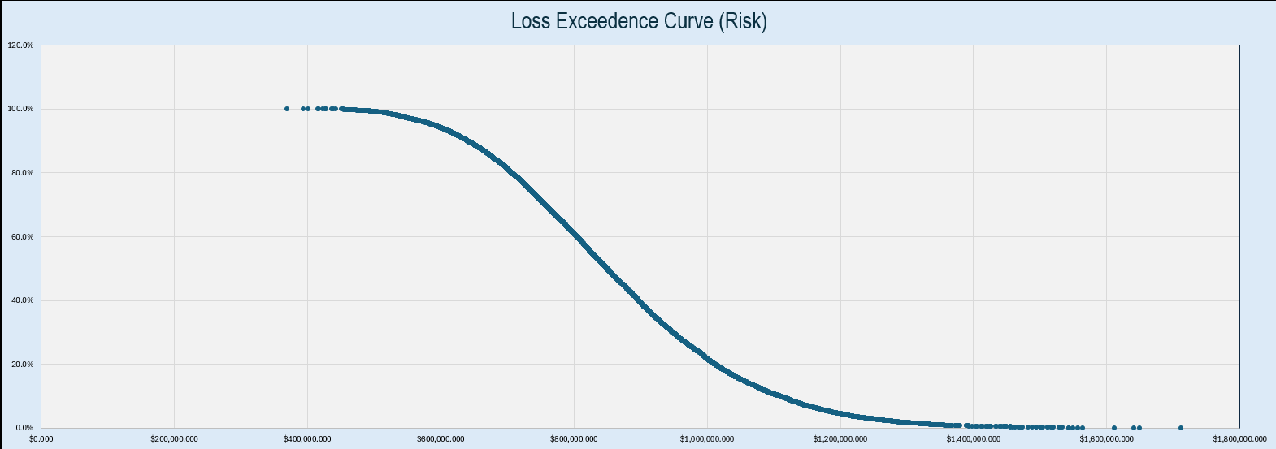
Risk Report

Slide 6
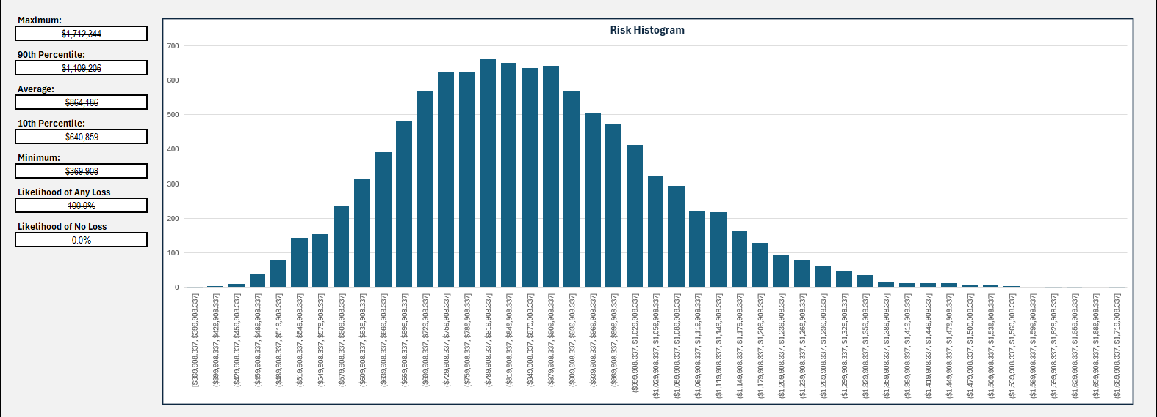
Risk Report

Slide 7
What These Results Mean for HTU
Risk Posture Assessment
High-frequency risk → recurring incidents
High-impact losses → six-figure cost per event
Weak controls → systemic vulnerability
Business Impact
Financial losses are predictable and recurring
Academic integrity and trust are at risk
Reputation damage amplifies financial exposure

